Slide 1

Multi-Perspective and Predictive Analysis of Forests; the Issues, Challenges and Global Trends
Kiran Babu Thatha, Marcel Schulte, Obinna Patrick Nkwocha, Shweta Pandey, Thorben Hebbelmann

Slide 2

Introduction

Slide 3
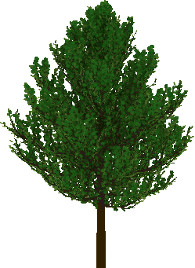
Initial Questions
1
A general overview of global forest development over the last 30 years
Show deforestation and reforestation trends and investigate possible correlations
Analyze forest destruction by natural causes
Temperature increase and wildfire prediction
Relation of forest with other environmental issues
Prediction of how much forest area has to be further increased to tackle all greenhouse gas emissions.

Slide 4
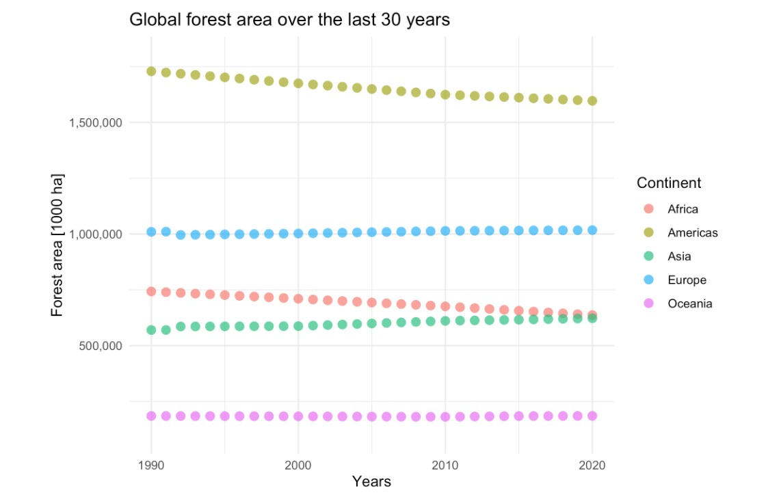
Global Forest Development (1990 - 2020)
2

Slide 5
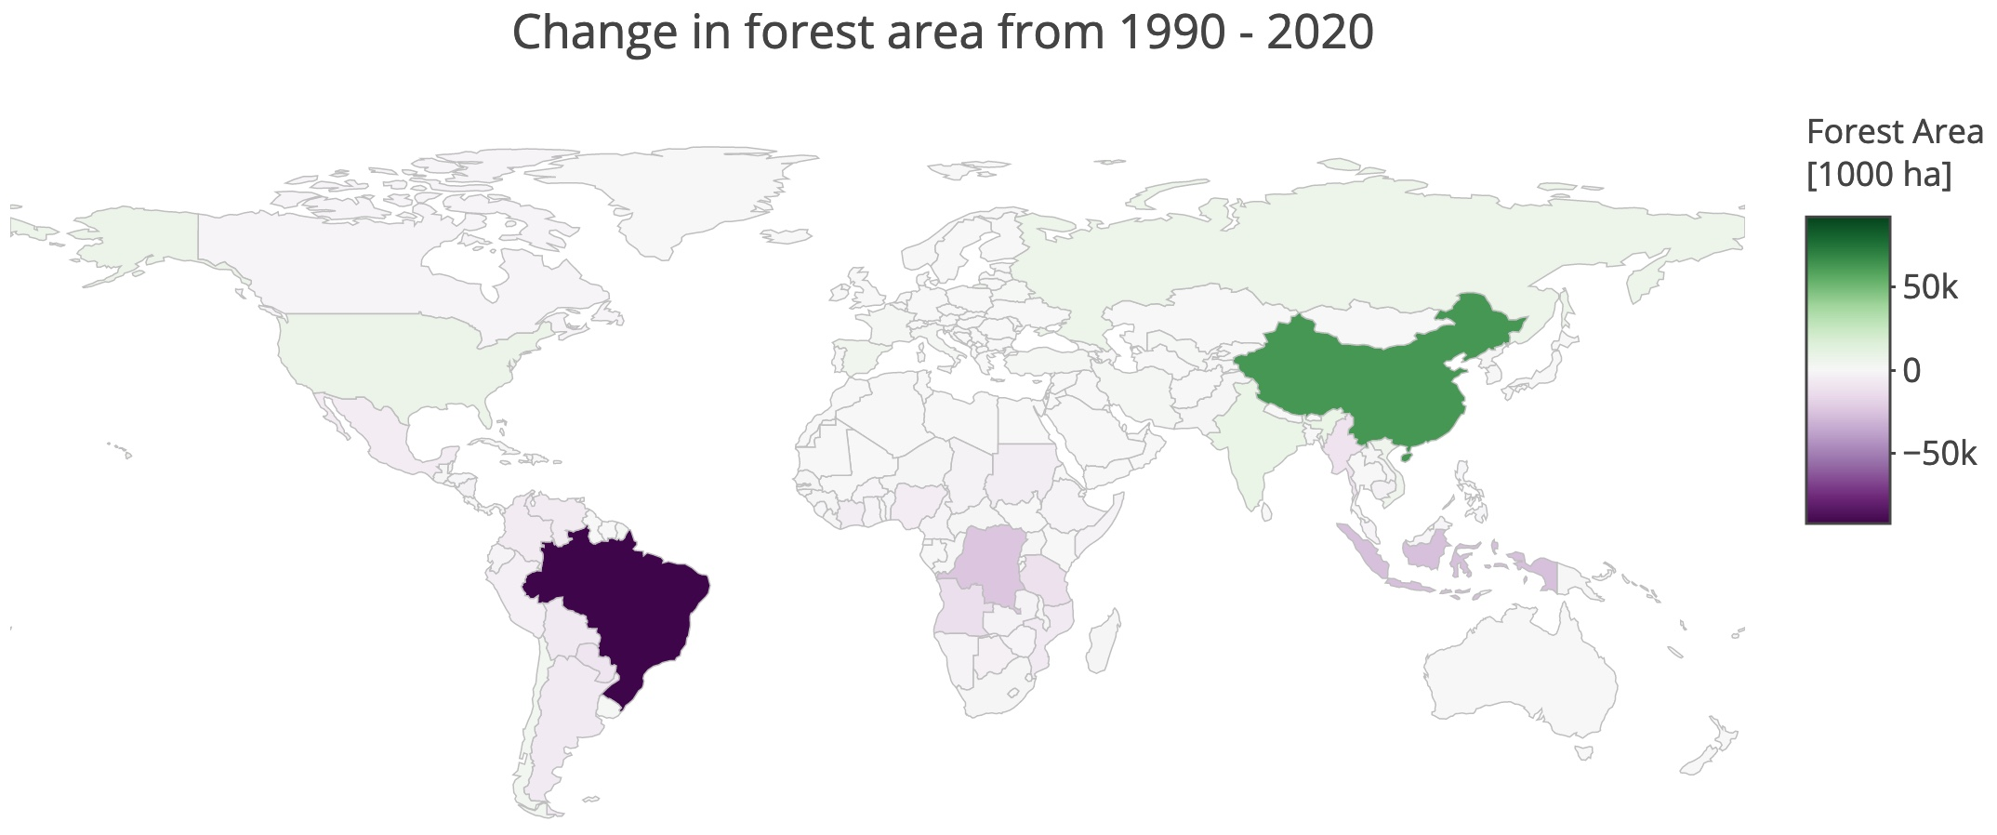
Global Change in Forest Area (1990-2020)
3

Slide 6
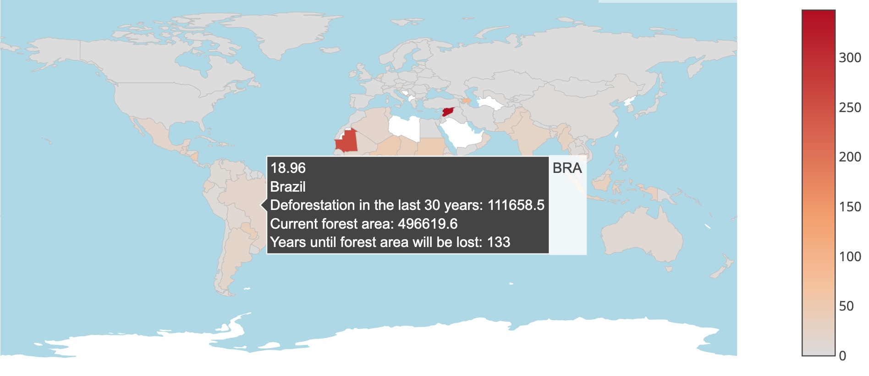
Deforestation Analysis (1990 to 2020)
4
*Forest Area [1000ha]

Slide 7
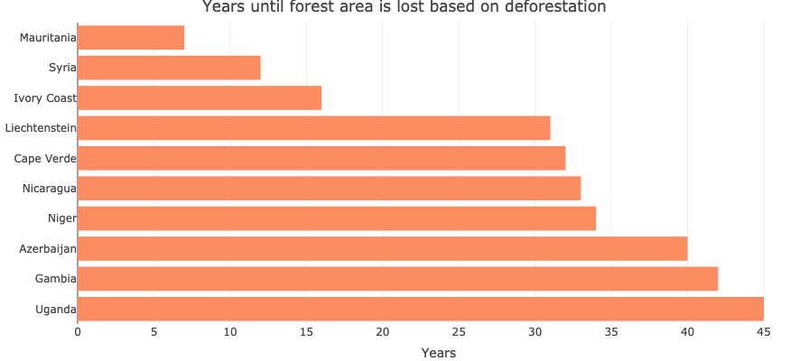
Deforestation Impact
5
Rainforest, such as Nicaragua, Uganda or Ivory Coast should be highlighted.
Why Brazil is missing?(given recent reports)
The area of burned forests are extraordinary high.
Brazil would lose it’s forests far earlier: in 20 instead of 133 years.

Slide 8
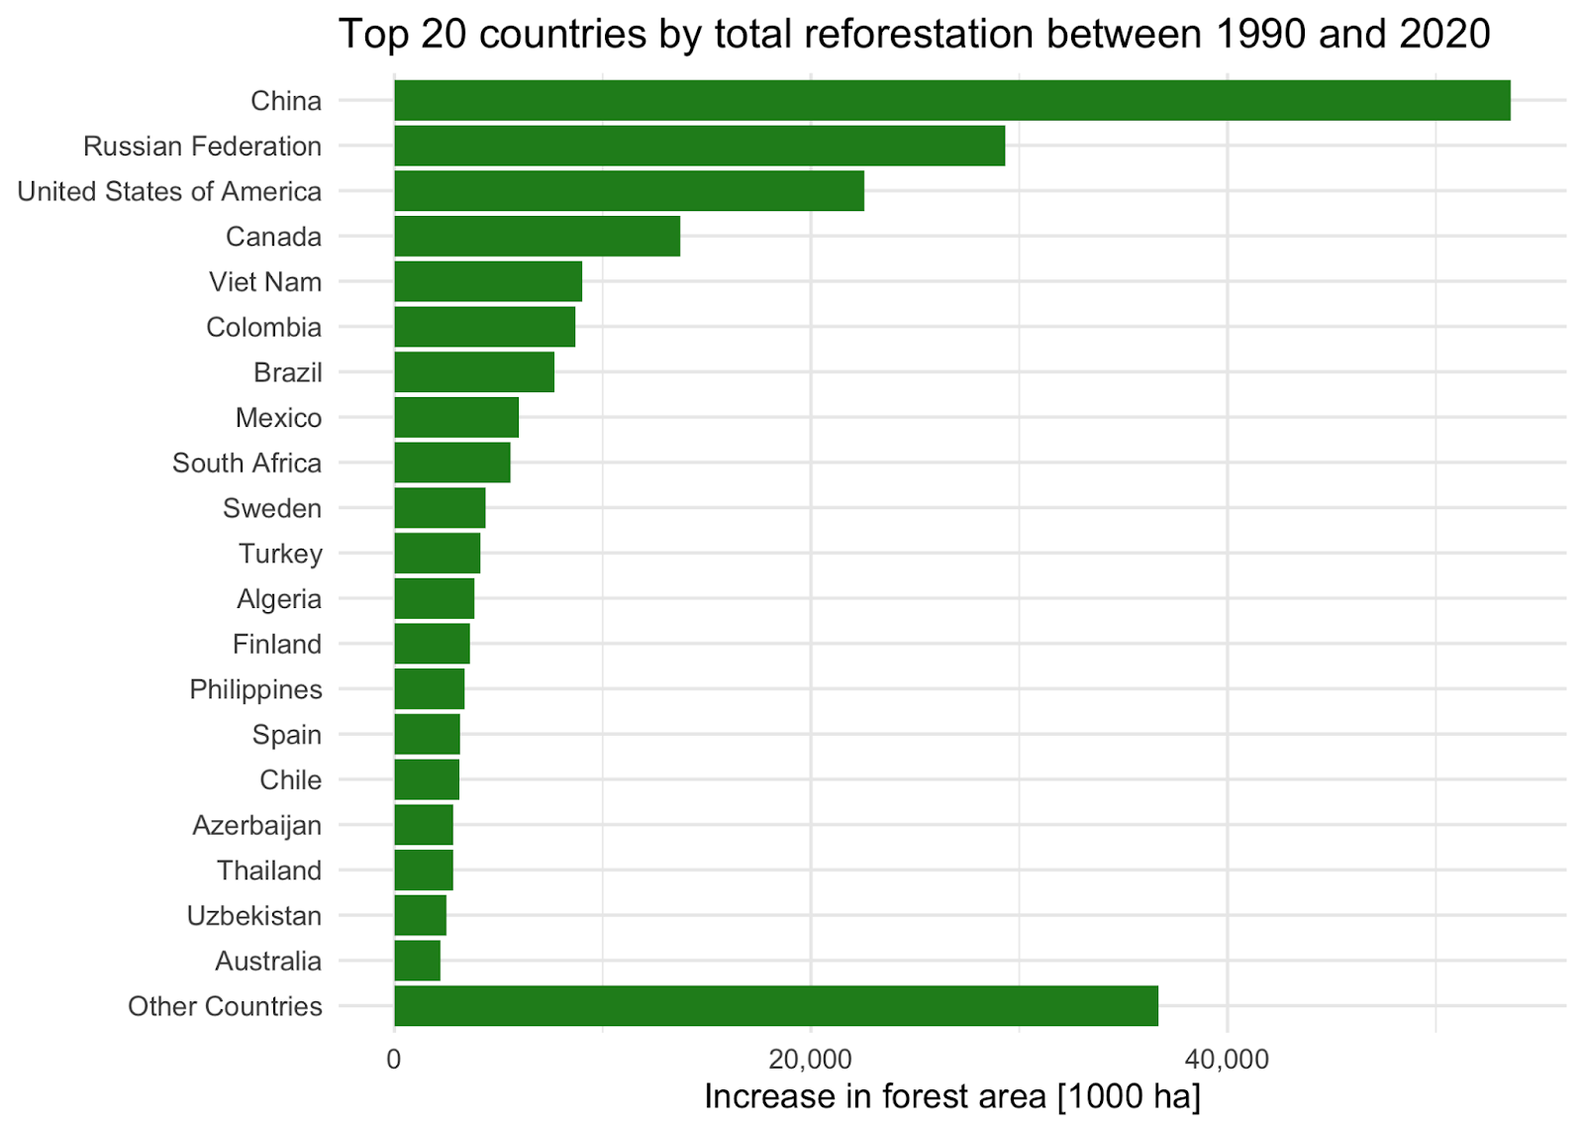
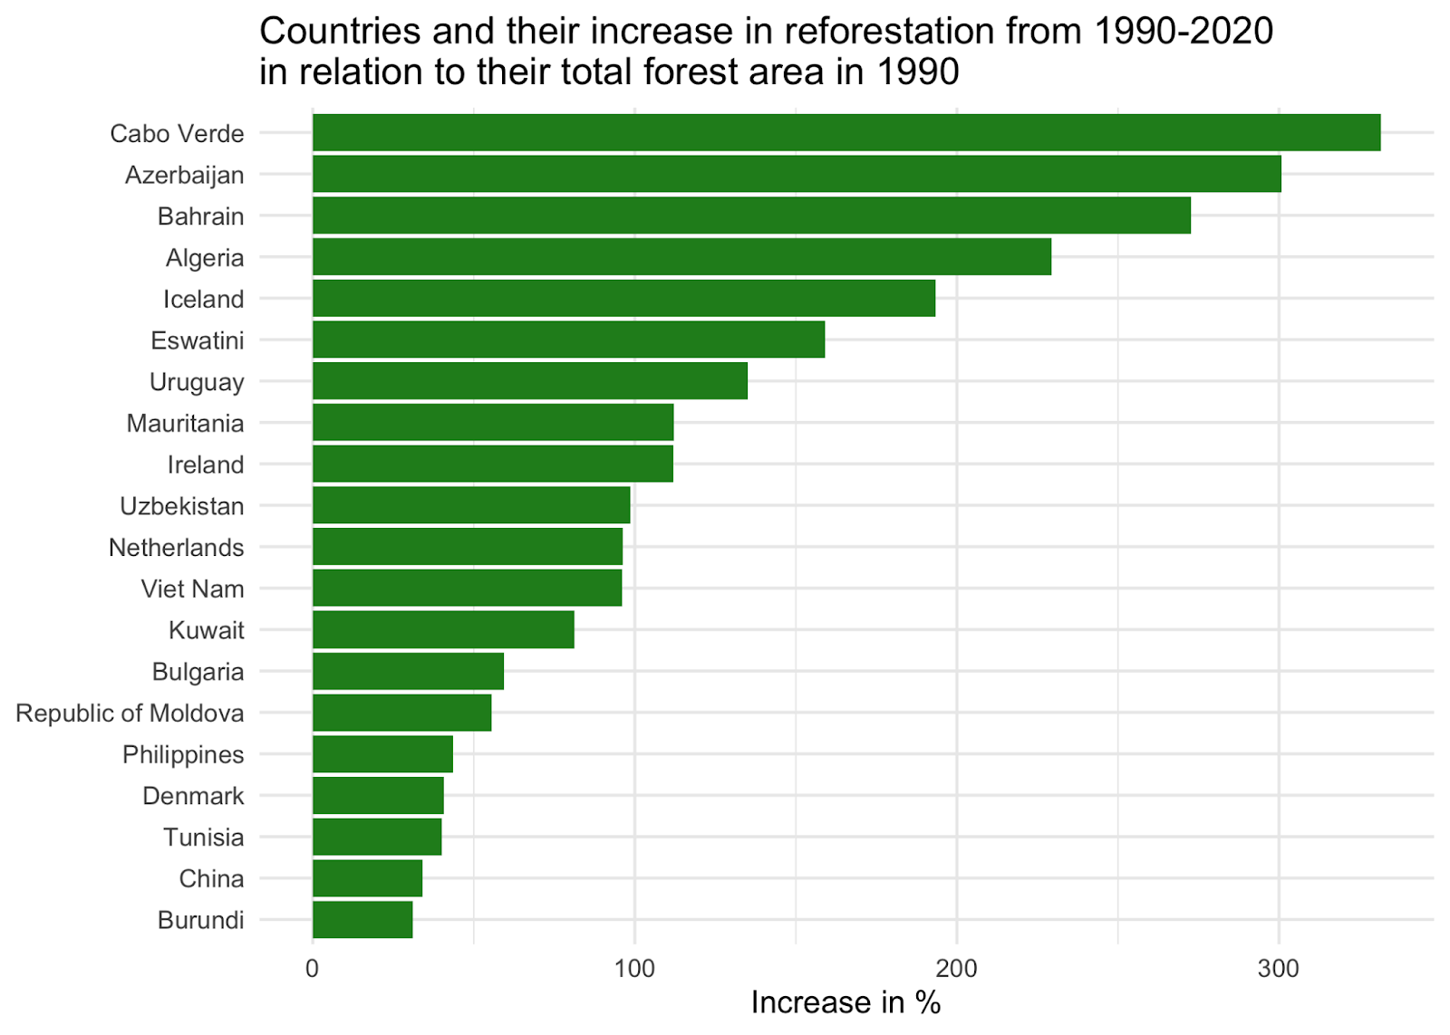
Drivers of Reforestation
6

Slide 9
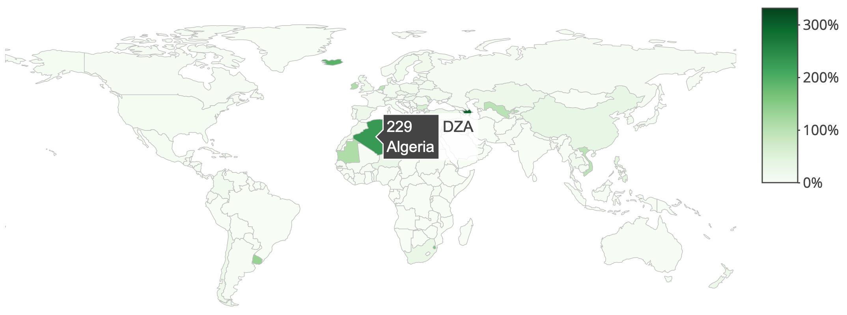
Increase in Reforestation (1990 to 2020)
7

Slide 10
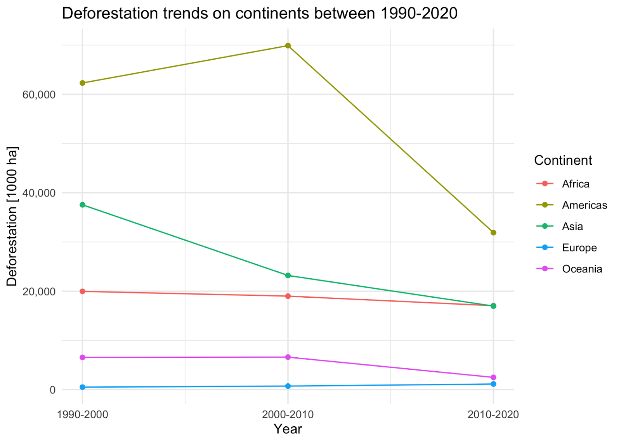
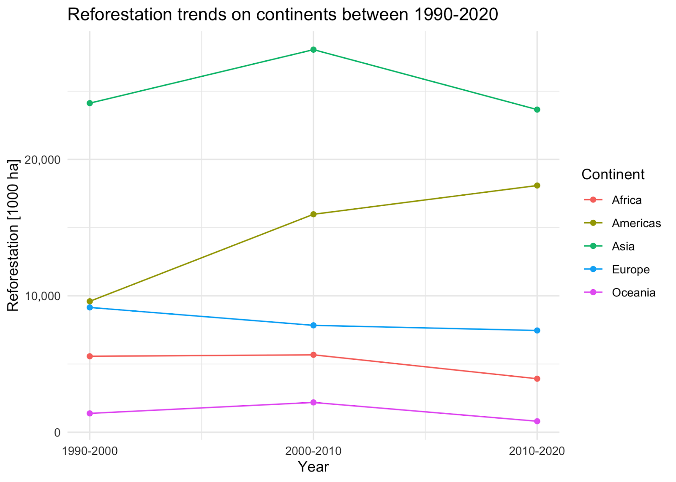
Deforestation & Reforestation Trends
8

Slide 11
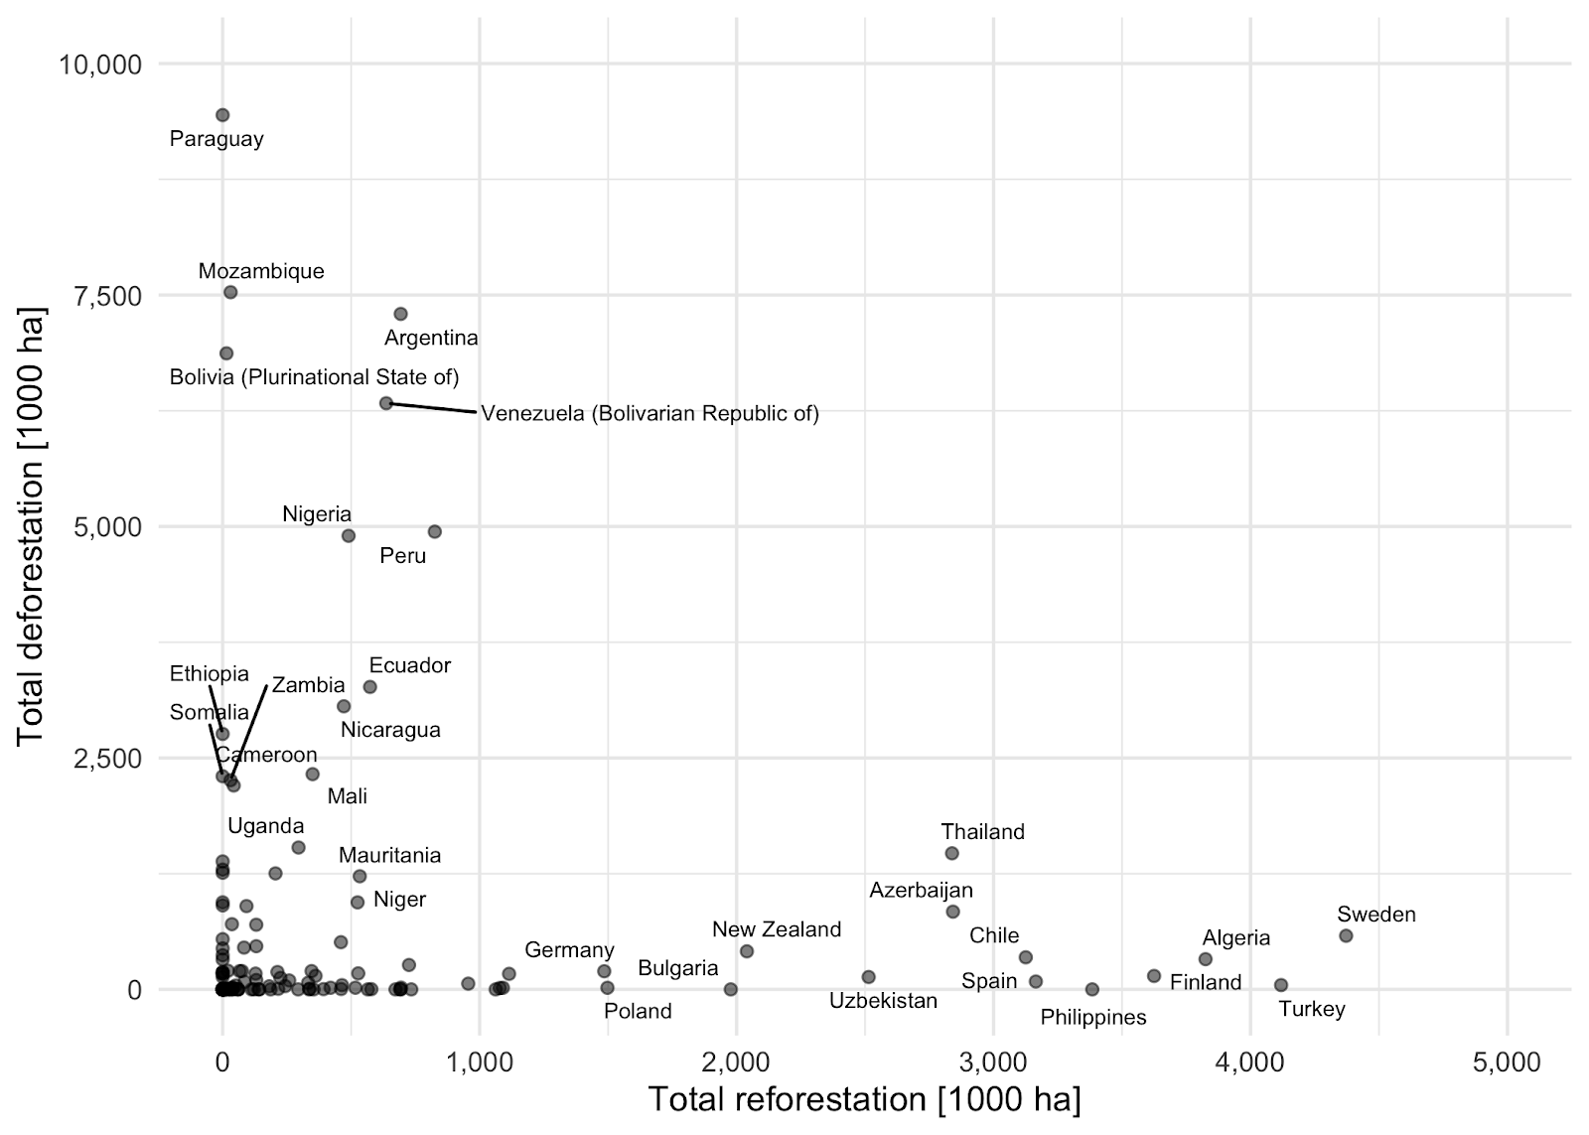
Relation between Deforestation & Reforestation
9
Correlation: 0.54
Predictive Power score: 0.14

Slide 12
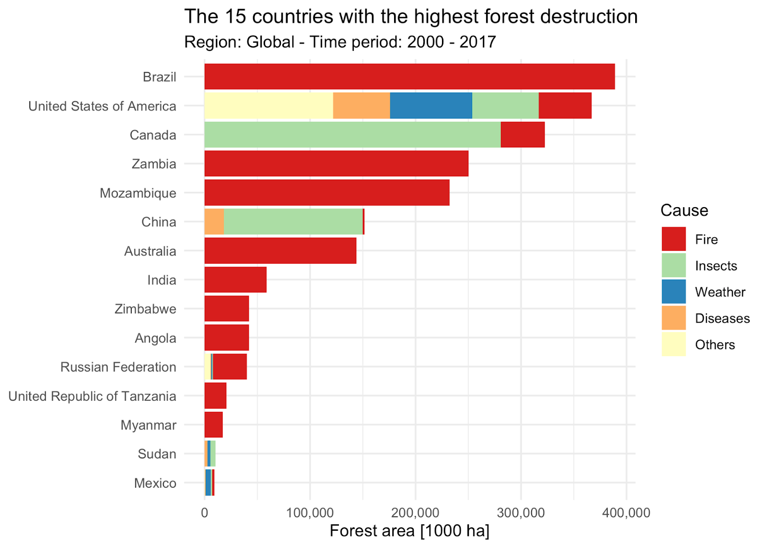
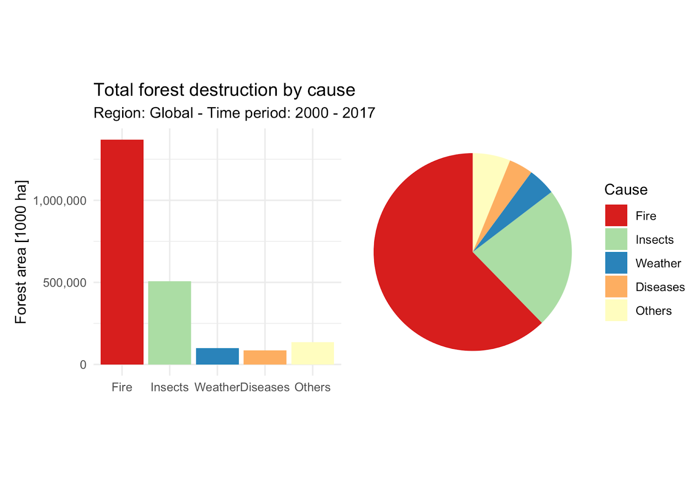
Forest Destruction
10

Slide 13
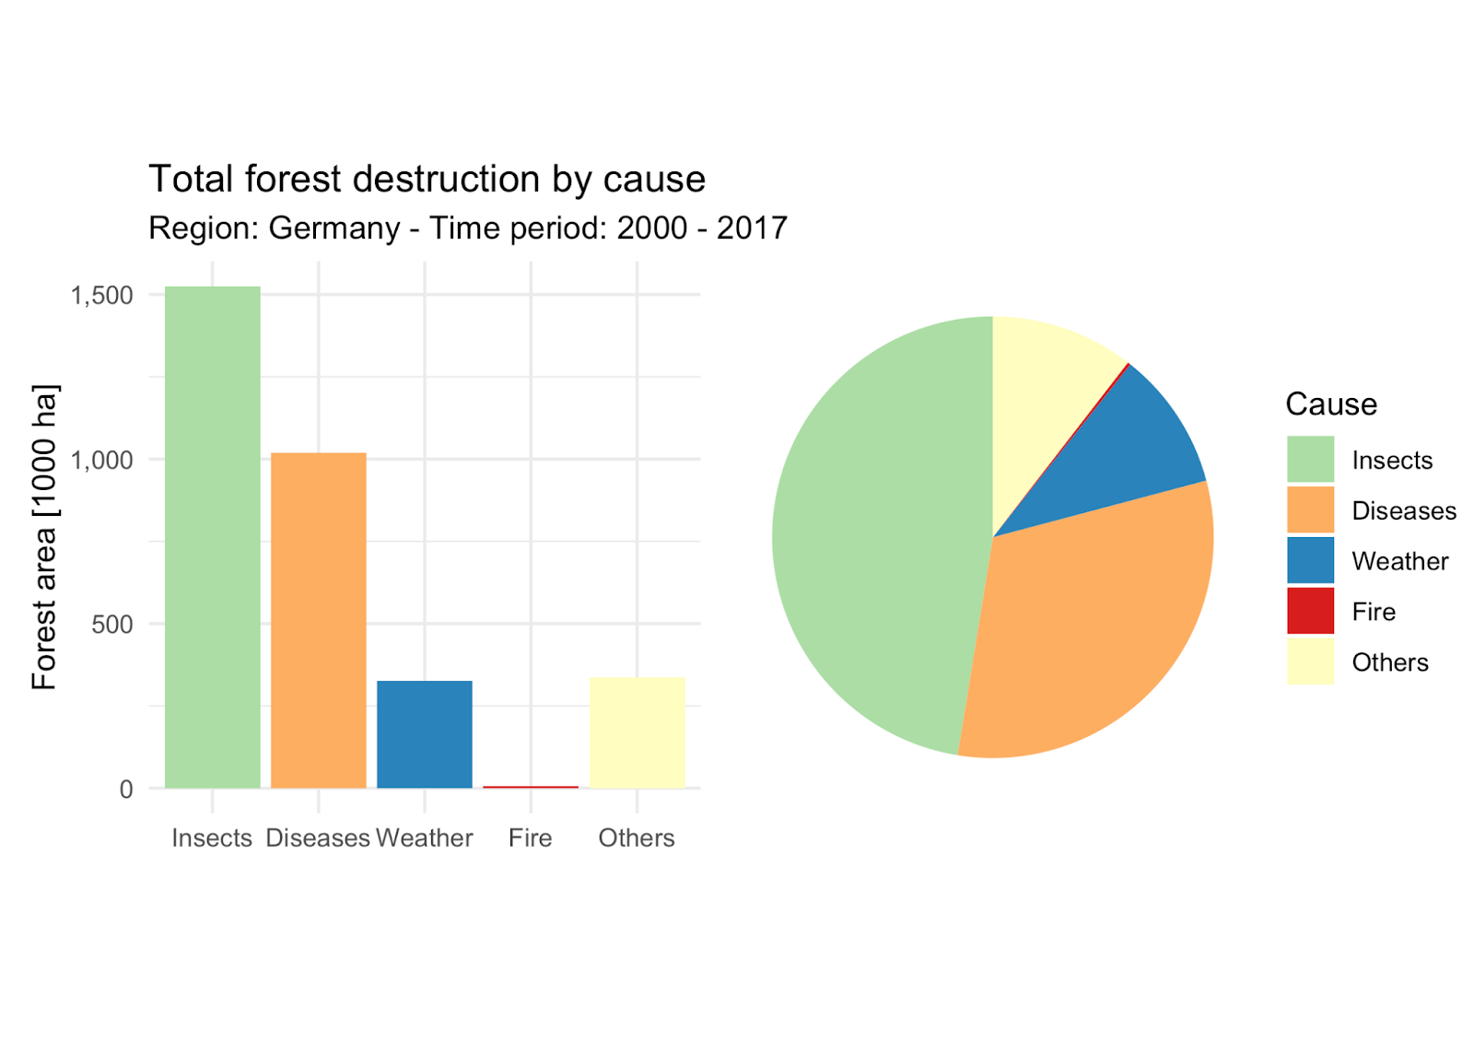
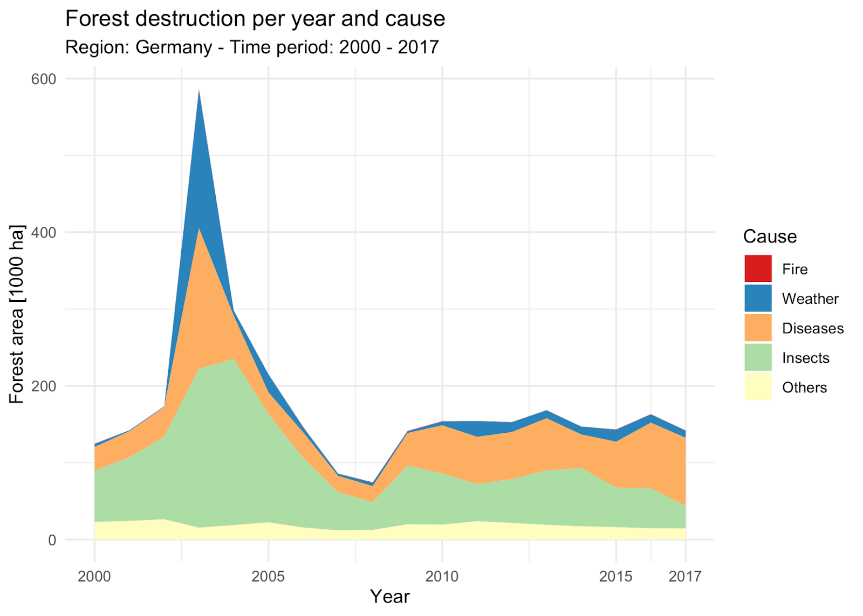
Forest Destruction in Germany
11

Slide 14
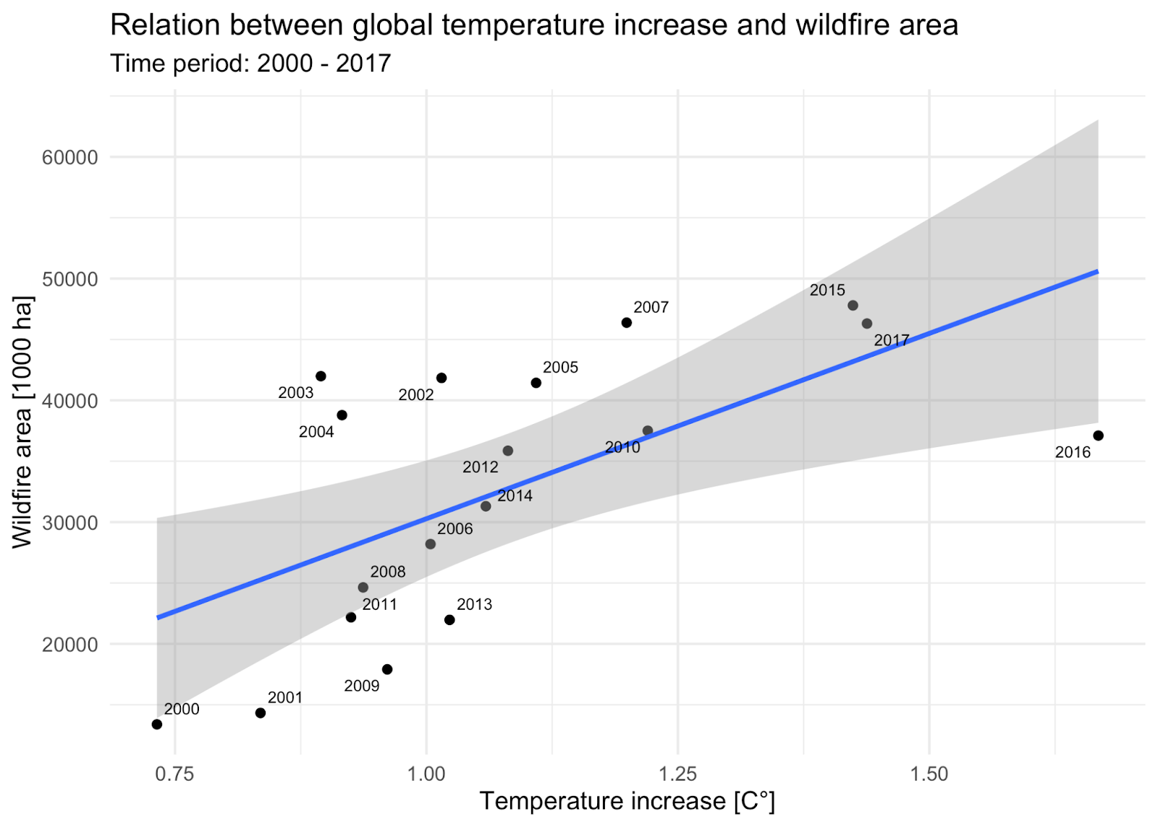
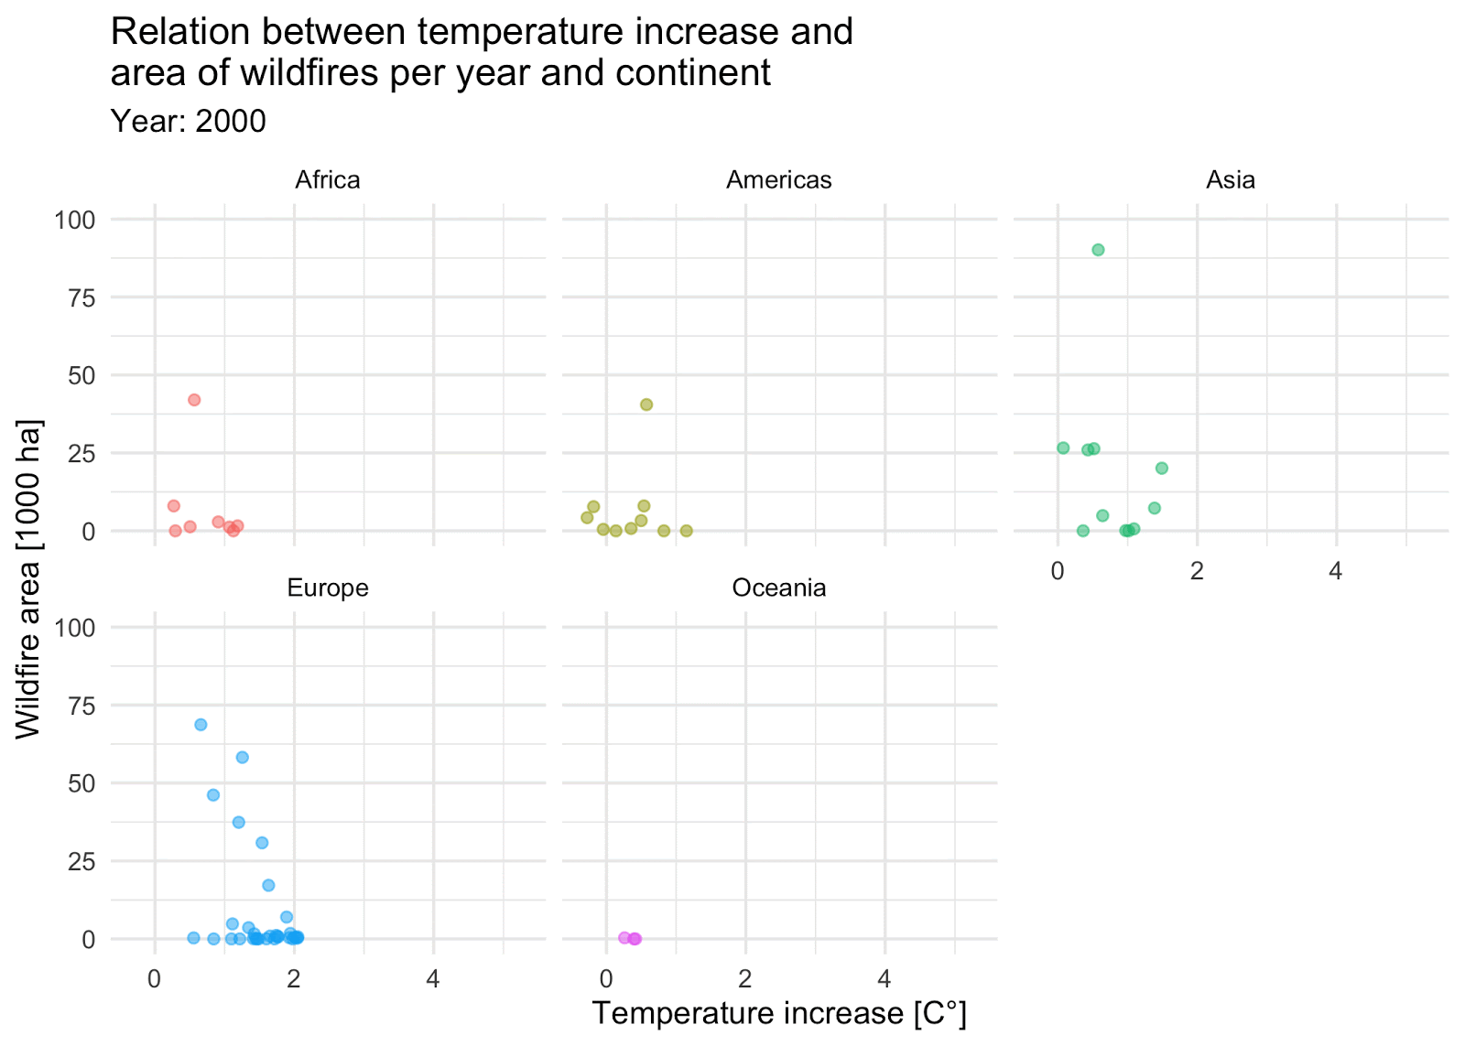
Rising Temperatures and Wildfires
12

Slide 15
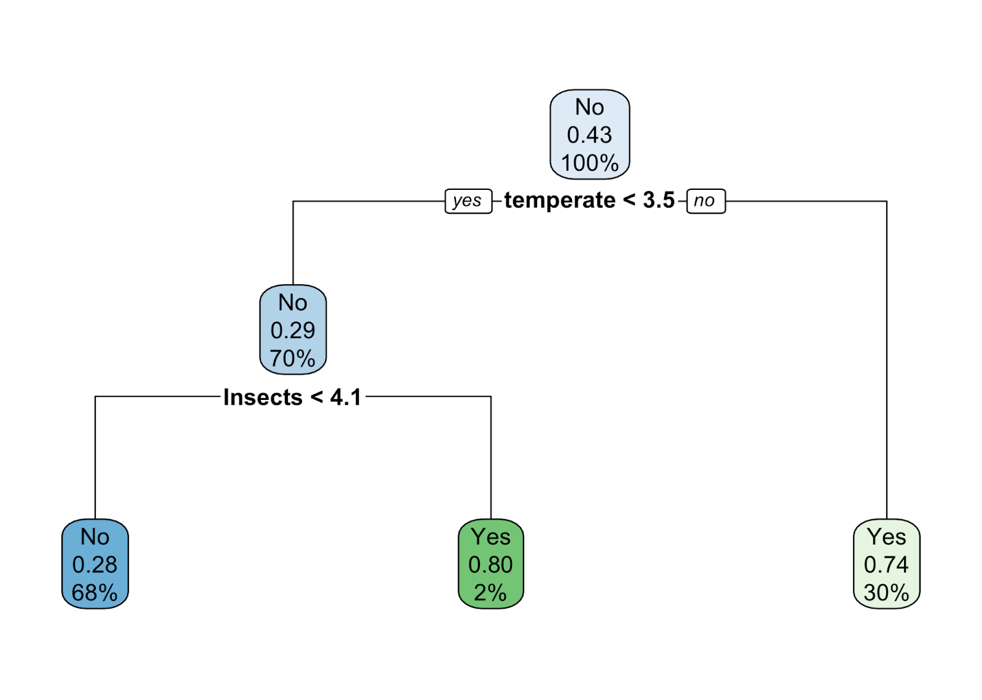
Wildfire Predictions
13
Decision Tree
Binary Classification
Predictors
Forest destruction by insects
Amount of temperate forest
Accuracy: 73%

Slide 16
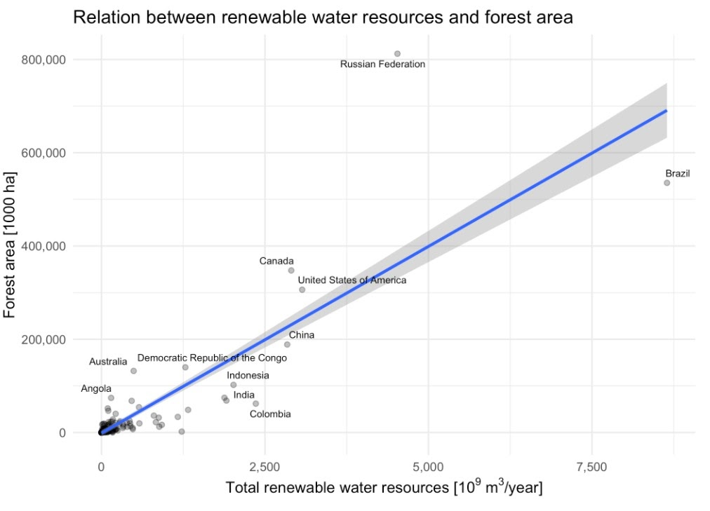
Available Water
14
Correlation: 0.88

Slide 17
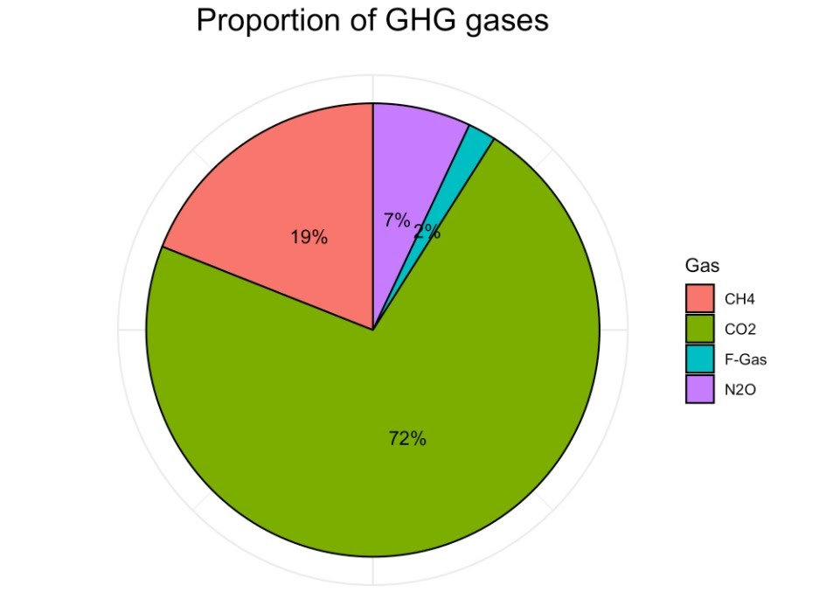
Greenhouse Gases
15

Slide 18
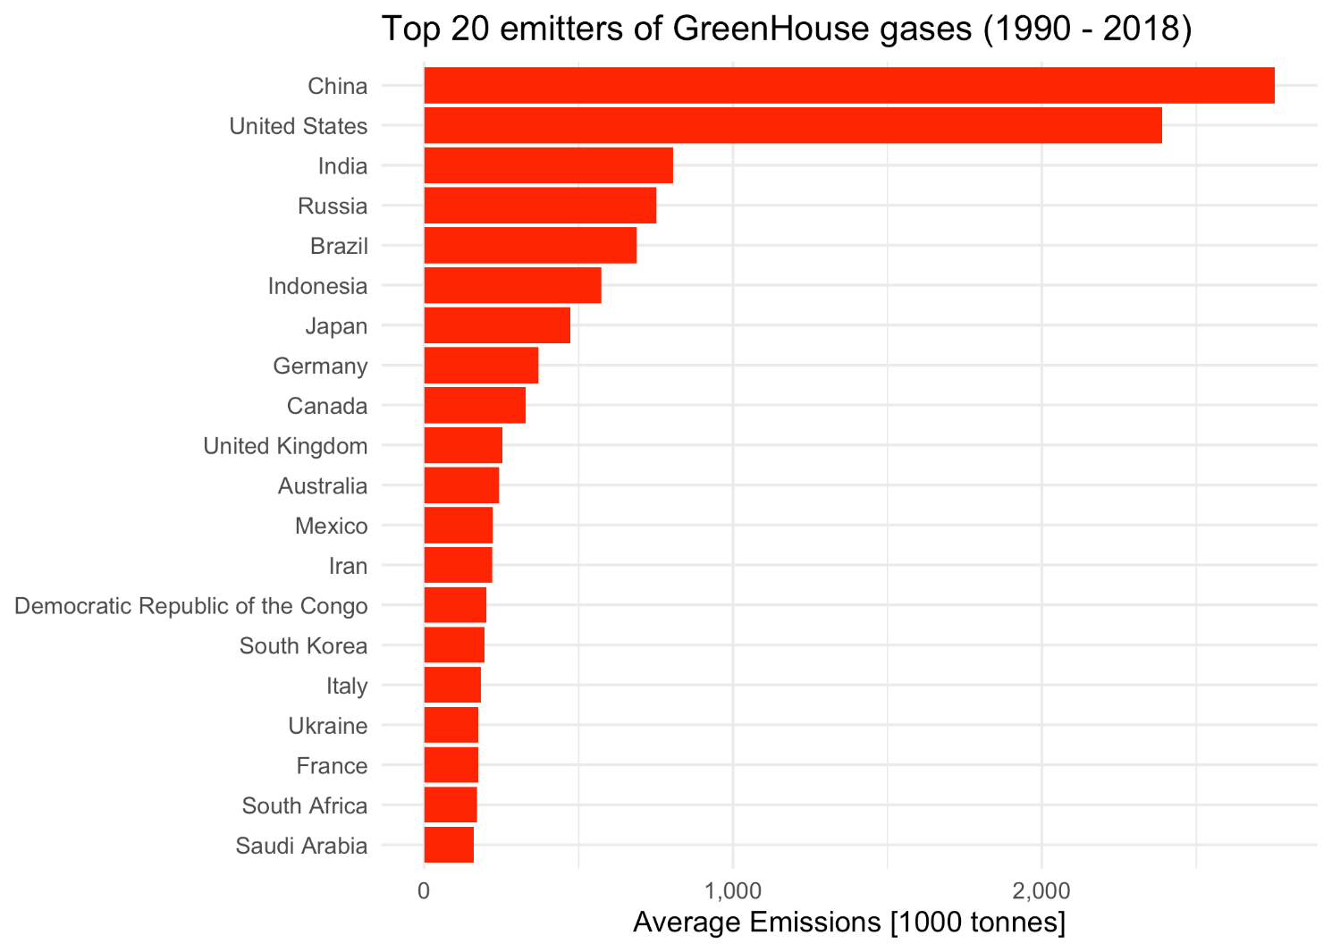
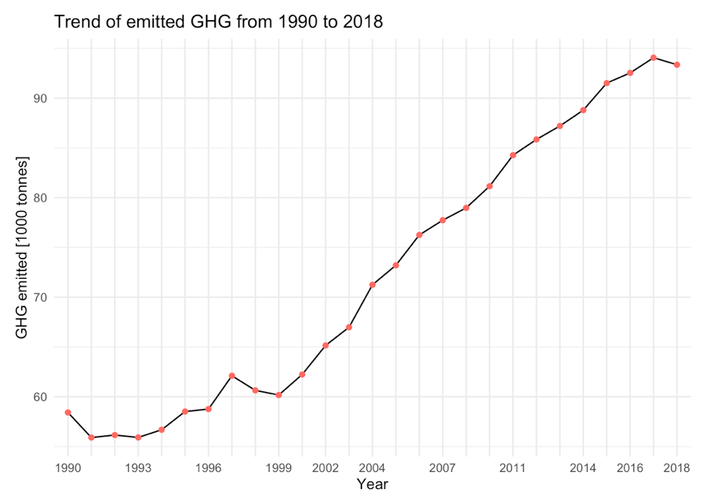
GHG Emitters and Trends
16

Slide 19
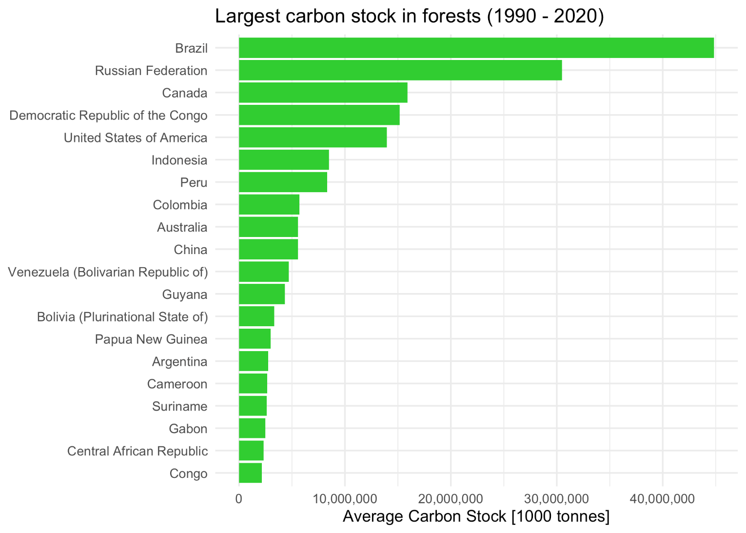
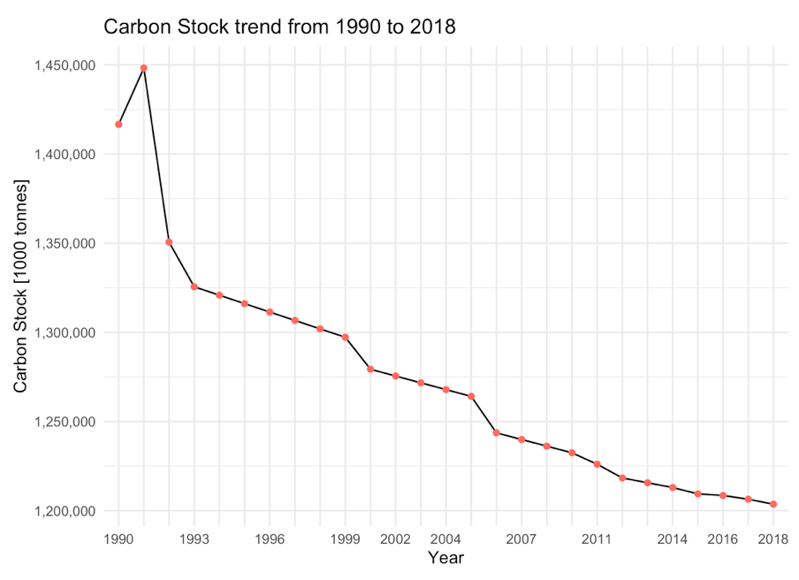
Carbon Stock
17

Slide 20
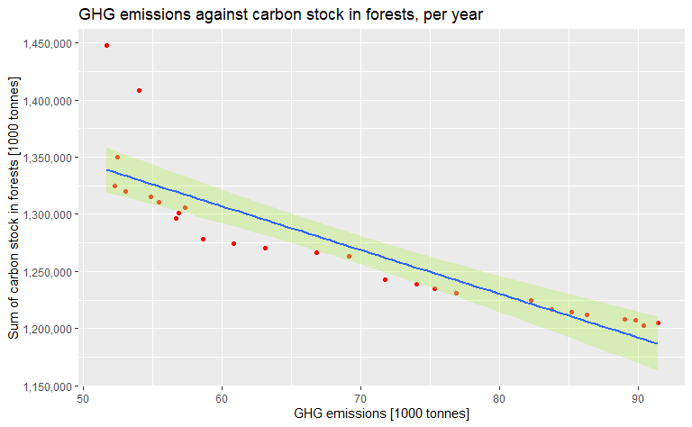
Carbon Stock - GHG emission
18
Correlation:
- 0,95

Slide 21
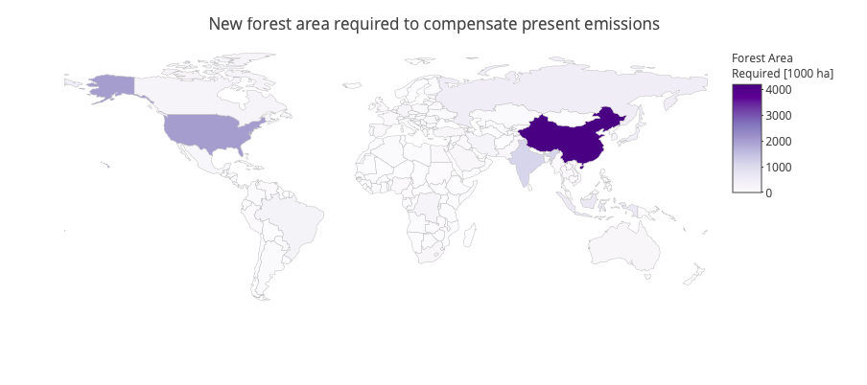
Required Forest Area
19

Slide 22

Summary
20
China: highest forest area increase (62 million ha)
Brazil:
highest forest area decrease (-92 million ha)
risks to lose forests in 20 years
Main cause of destruction worldwide:
wildfires (>50% - 1 billion ha in 17 years)
Type of forest and appearance of insects are main
factors for wildfire predictions
1000 ha increase in forest area would decrease CO2 by 2.5Kg
China and the US need to expand forest area tremendously

Slide 23
Thank You!
Any Questions?

